Slide 1

DEPARTMENT OF COMPUTER SCIENCE Project Presentation (KCS 851) Drowsiness Driver Detection System
Under supervision of
Prof. Puneet Kumar Goyal (Assistant Professor)
Submitted by
1. Sarthak Tyagi 8-c (2000290120137)
2. Utkarsh Mishra 8-c (2000290120179)
3. Shruti Gupta 8-c (2000290120156)

Slide 2
Problem Statement
The aim is to design and develop a Drowsiness Driver Detection System that can accurately identify when a driver is distracted and provide timely alerts to prevent potential accidents. This system should utilize advanced technologies such as computer vision, machine learning, and sensor data to monitor the driver’s behavior in real-time.

Slide 3
Objectives
Real-time Monitoring: Continuously monitor the driver’s facial expressions, eye movements, and head position using in-car cameras and sensors.
Distraction Detection: Use machine learning algorithms to analyze the captured data and detect various forms of distractions such as looking away from the road, using a mobile phone, or closing eyes for prolonged periods.
Alert Mechanism: Implement an alert system that provides audible and visual warnings to the driver when a distraction is detected.
User Interface: Develop an intuitive user interface for system configuration, real-time monitoring, and viewing distraction history.

Slide 4
Technology Used
Computer Vision:
OpenCV for real-time image processing and analysis.
Dlib for facial landmark detection and tracking.
Machine Learning:
Pycham is a popular integrated development environment (IDE) for Python programming.
Imutils- Python library designed to simplify basic image processing tasks.
Alert System:
Integration with the car's audio system for audible alerts.
In-car display or mobile application for visual alerts.
Algorithm Used :
Collects real-time data from facial recognition cameras, eye-tracking sensors, and physiological monitors.
Applies noise reduction and normalization to enhance data quality.

Slide 5
Literature Survey
Paper 1: Distracted Driver Detection Based on a CNN With Decreasing
Summary:
This research paper focuses on detection of distracted driving by the rapidly
developing deep learning technology. The D-HCNN model achieves good
driver posture classification accuracy. To satisfy the above contradictory
requirements, the design of D-HCNN considers the following two points:
(1) Parameter quantity reduction and accuracy promotion. First, the original
images contain considerable amounts of background noise, such as the color
of clothing and light, and we are only interested in the driver’s posture.
(2) High speed. Most of the parallelism of a convolutional network is reflected
in the calculation of each layer, and there is generally no parallelism between
layers.

Slide 6
Literature Survey
Paper 2: Towards a Context-Dependent Multi-Buffer Driver Distraction Detection Algorithm
Summary:
Driver distraction detection systems are typically based on
(i) lateral and longitudinal driving performance measures,
(ii) electrophysiological recordings or
(iii) gaze information. In the presented case study, the combined AttenD2.0 output and AttenD follow rather similar patterns,
indicating inattention when engaged in the NDRA and showing a rather high level of alertness otherwise. AttenD reacts slightly more to the drivers’ looking for the confirmation button upon handing over and taking back control. This is connected to the fact that in AttenD2.0 the distraction classification for off- forward glances is slightly delayed, due to the shape of the decrement function, and because mostly the forward buffer is affected, while the mirror buffers only decrease slightly.

Slide 7
Literature Survey
Paper 3: A Triple-Wise Multi-Task Learning Framework for Distracted Driver Recognition
Summary:
Distracted driving has become a huge threat to human society. TML
generates triplets composed of a raw image, a positive sample, and a
negative sample. The positive sample maintains the same global spatial
structure. as the raw input but smoothens the local texture of the human
body region. The negative sample is generated by keeping the same local
information as the raw input but destroying the global spatial structure.
Thereafter, TML reduces CNN’s local bias by exploring information among
the triplets with a multi-task learning strategy.

Slide 8
Literature Survey
Paper 4: A Hybrid CNN Framework for Behavior Detection of Distracted Drivers
Summary:
Gesture patterns are less distinguishable in vehicles due to in-vehicle physical constraints and body occlusions from the drivers. However, by capitalizing on modern camera technology, convolutional neural network (CNN) can be used for visual analysis. In this paper, we present a hybrid CNN framework (HCF) to detect the behaviors of distracted drivers by using deep learning to process image features. Features are extracted at different scales by three cooperative pretrained CNN models; then, the features are concatenated to obtain the feature maps. Subsequently, we train the fully connected layer to classify each distracted driving behavior. During the training procedure, we apply dropout technology to prevent the training model from overfitting to the training data. We apply CAM to highlight the detection area results. The results show that the proposed HCF achieves good performance for recognizing distracted driver behaviors, reaching a classification accuracy of 96.74%,

Slide 9
Literature Survey
Paper 5: Distracted Driver Detection using Stacking Ensemble
Summary:
While driving the vehicle, drivers frequently perform secondary activities that distract driving. A decrease in driver distraction is a critical aspect of the smart transportation system. To decrease accidents and improve safety. This study represents a distracted driver detection, which is based on different CNN architectures, which include VGG19, InceptionV3, Xception, and ResNet50. The proposed model performs better than pre-trained models and takes less computational time also. Thus, stacked ensemble approach achieves better performance than other models presented in earlier research. This system has the potential to be implemented in real cars to prevent road accidents.

Slide 10
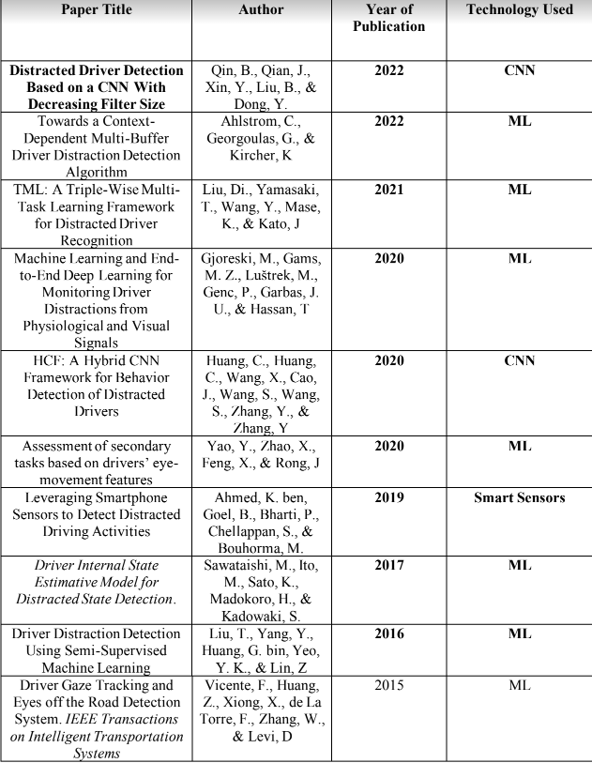
Literature Survey

Slide 11
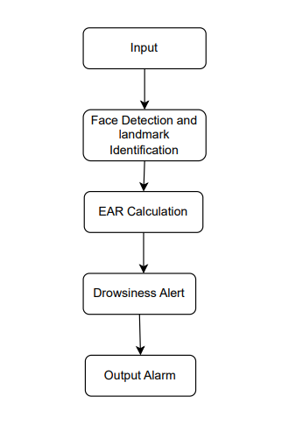
Diagrams
DFD Level-0

Slide 12
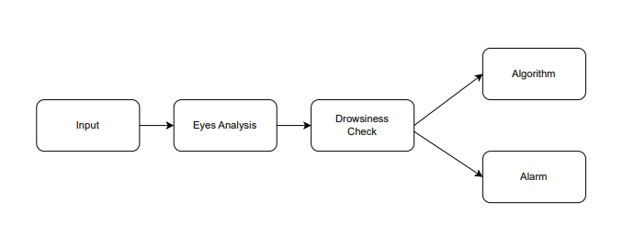
DFD Level-1

Slide 13
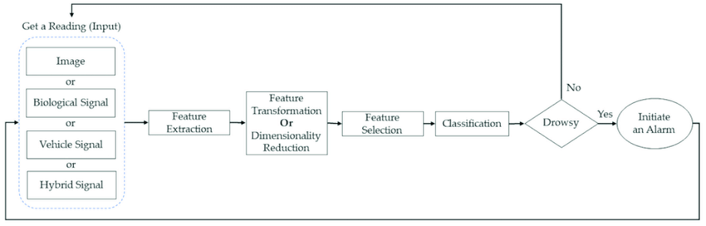
DFD Level-2

Slide 14
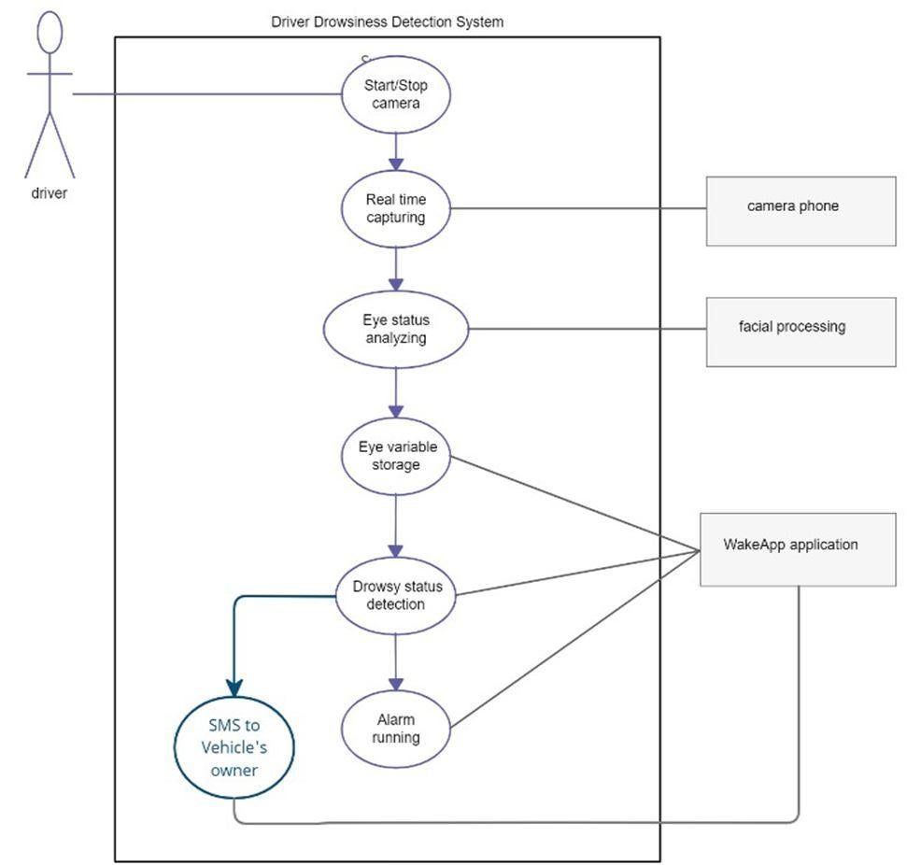
UseCase Diagram

Slide 15
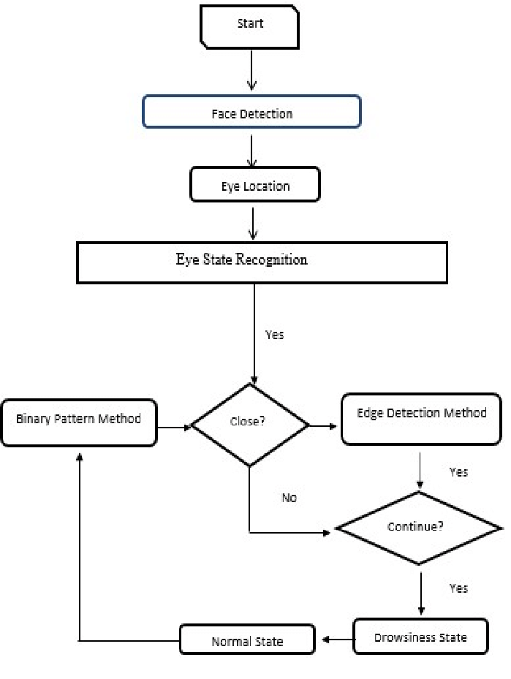
Flow Chart

Slide 16
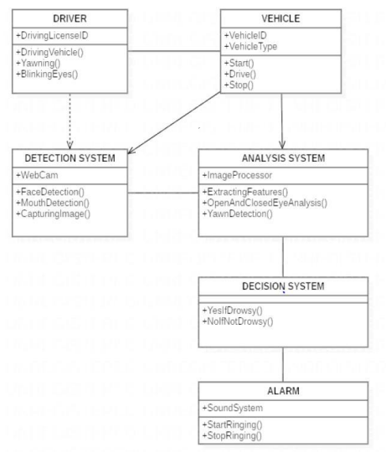
Class Diagram

Slide 17
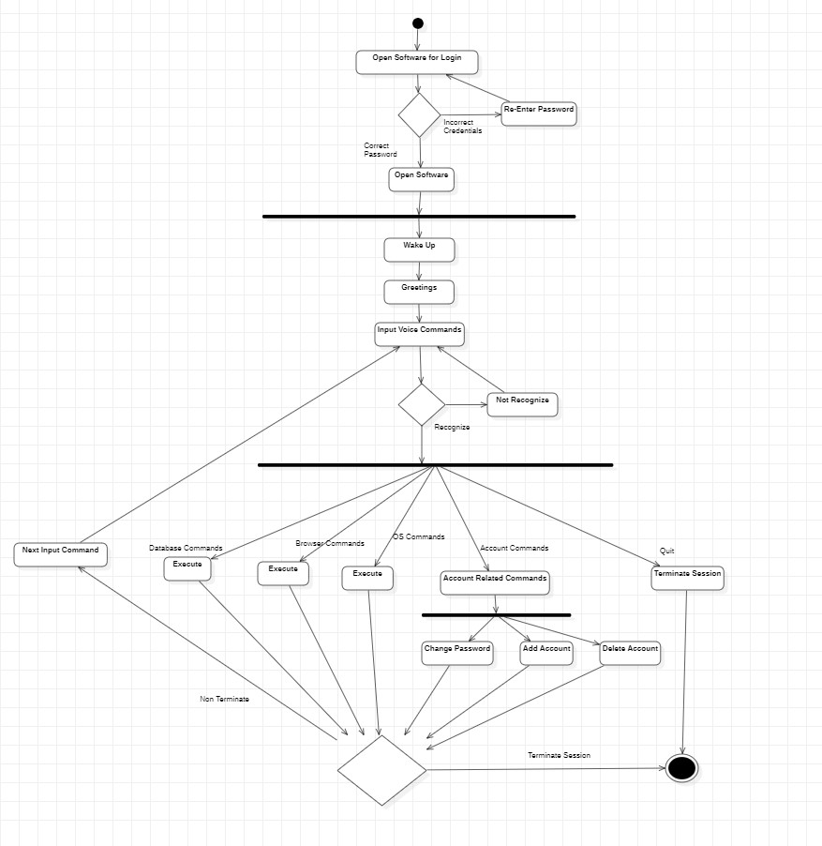
Activity Diagram

Slide 18
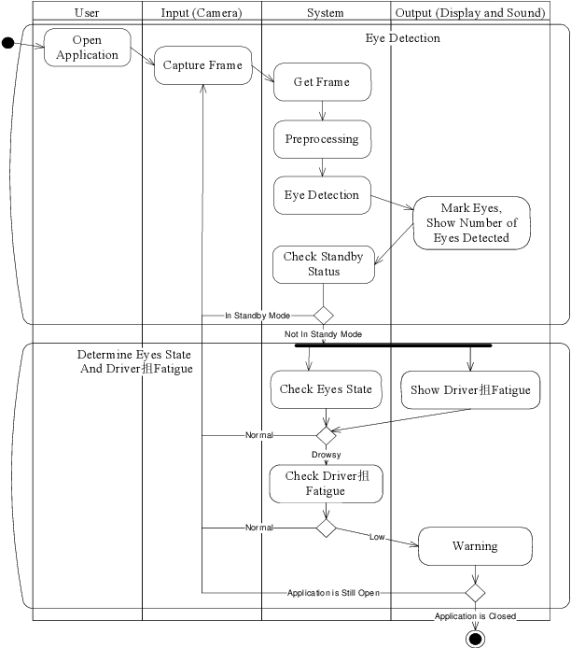
Sequence Diagram

Slide 19
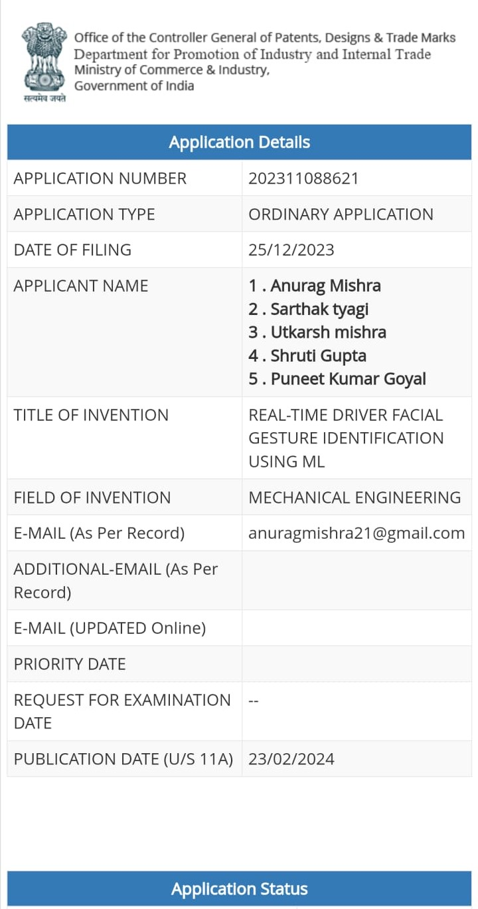
Patent Status
Proof of publication

Slide 20

Research Paper Status
Submission Proof:

Slide 21
Project Status
100% completed
Github Link : CS-2024-C/PCS24-72-SarthakTyagi at main · KIET-Github/CS-2024-C · GitHub

Slide 22
All documents Proofs
Hyperlink of the testing report: https://drive.google.com/drive/u/1/folders/1gxz5D5MhLdlqPXmsdmRCPxfhqmSG4lky
Hyperlink of the Synopsis: Project Documents - Google Drive
Hyperlink of Report: Project Documents - Google Drive

Slide 23
References
B. Qin, J. Qian, Y. Xin, B. Liu, and Y. Dong, "Distracted Driver Detection Based on CNN With Decreasing Filter Size," IEEE Transactions on Intelligent Transportation Systems, vol. 23, no. 7, pp. 6922-6933, Jul. 2022. doi: 10.1109/TITS.2021.3063521.
C. Ahlstrom, G. Georgoulas, and K. Kircher, "Towards a Context-Dependent MultiBuffer Driver Distraction Detection Algorithm," IEEE Transactions on Intelligent Transportation Systems, vol. 23, no. 5, pp. 4778–4790, May 2022. doi: 10.1109/TITS.2021.3060168.
D. Liu, T. Yamasaki, Y. Wang, K. Mase, and J. Kato, "TML: A Triple-Wise MultiTask Learning Framework for Distracted Driver Recognition," IEEE Access, vol. 9, pp. 125955–125969, 2021. doi: 10.1109/ACCESS.2021.3109815.
M. Gjoreski, M. Z. Gams, M. Luštrek, P. Genc, J. U. Garbas, and T. Hassan, "Machine Learning and End-to-End Deep Learning for Monitoring Driver Distractions from Physiological and Visual Signals," IEEE Access, vol. 8, pp. 70590–70603, 2020. doi: 10.1109/ACCESS.2020.2986810.
C. Huang, C. Huang, X. Wang, J. Cao, S. Wang, S. Wang, Y. Zhang, and Y. Zhang, "HCF: A Hybrid CNN Framework for Behavior Detection of Distracted Drivers," IEEE Access, vol. 8, pp. 109335–109349, 2020. doi: 10.1109/ACCESS.2020.3001159.
Y. Yao, X. Zhao, X. Feng, and J. Rong, "Assessment of secondary tasks based on drivers’ eye-movement features," IEEE Access, vol. 8, pp. 136108–136118, 2020. doi: 10.1109/ACCESS.2020.3010797.
K. ben Ahmed, B. Goel, P. Bharti, S. Chellappan, and M. Bouhorma, "Leveraging Smartphone Sensors to Detect Distracted Driving Activities," IEEE Transactions on Intelligent Transportation Systems, vol. 20, no. 9, pp. 3303–3312, Sep. 2019. doi: 10.1109/TITS.2018.2873972.
M. Sawataishi, M. Ito, K. Sato, H. Madokoro, and S. Kadowaki, "Driver Internal State Estimative Model for Distracted State Detection," 2017. doi: 10.0/Linux-x86_64.
T. Liu, Y. Yang, G. bin Huang, Y. K. Yeo, and Z. Lin, "Driver Distraction Detection Using Semi-Supervised Machine Learning," IEEE Transactions on Intelligent Transportation Systems, vol. 17, no. 4, pp. 1108–1120, Apr. 2016. doi: 10.1109/TITS.2015.2496157.
F. Vicente, Z. Huang, X. Xiong, F. de La Torre, W. Zhang, and D. Levi, "Driver Gaze Tracking and Eyes off the Road Detection System," IEEE Transactions on Intelligent Transportation Systems, vol. 16, no. 4, pp. 2014–2027, Aug. 2015.

Slide 24
C. D. Fitzpatrick, S. Samuel, and M. A. Knodler, "The Use of a Driving Simulator to Determine How Time Pressures Impact Driver Aggressiveness," Accident Analysis & Prevention, vol. 108, pp. 131–138, 2017.
T. Kerwin and B. J. Bushman, "Measuring the Perception of Aggression in Driving Behavior," Accident Analysis & Prevention, vol. 145, p. 105709, 2020.
Y. Ma, K. Tang, S. Chen, A. J. Khattak, and Y. Pan, "On-Line Aggressive Driving Identification Based on in-Vehicle Kinematic Parameters under Naturalistic Driving Conditions," Transportation Research Part C: Emerging Technologies, vol. 114, pp. 554–571, 2020.
M. R. Carlos, L. C. Gonzalez, J. Wahlstrom, G. Ramirez, F. Martinez, and G. Runger, "How Smartphone Accelerometers Reveal Aggressive Driving Behavior?—The Key Is the Representation," IEEE Transactions on Intelligent Transportation Systems, vol. 21, pp. 3377–3387, 2020.
M. Shahverdy, M. Fathy, R. Berangi, and M. Sabokrou, "Driver Behavior Detection and Classification Using Deep Convolutional Neural Networks," Expert Systems with Applications, vol. 149, p. 113240, 2020.
R. Carvalho Barbosa, M. Shoaib Ayub, R. Lopes Rosa, D. Zegarra Rodríguez, and L. Wuttisittikulkij, "Lightweight PVIDNet: A Priority Vehicle Identification Network for Intelligent Transportation Systems," Sensors, vol. 21, p. 3760, 2021.
J. C. Silva, M. Saadi, L. Wuttisittikulkij, D. R. Militani, R. L. Rosa, and D. Z. Rodriguez, "Light-Field Imaging Reconstruction Using Deep Learning Enabling Intelligent Autonomous Transportation System," IEEE Transactions on Intelligent Transportation Systems, pp. 1–9, 2021.
D. A. Ribeiro, J. C. Silva, R. Lopes Rosa, M. Saadi, S. Mumtaz, L. Wuttisittikulkij, D. Zegarra Rodríguez, and S. Al Otaibi, "Light Field Image Quality Enhancement by a Lightweight Deformable Deep Learning Framework for Intelligent Transportation Systems," Electronics, vol. 10, p. 1136, 2021.
P. Lara-Benítez, M. Carranza-García, and J. C. Riquelme, "An Experimental Review on Deep Learning Architectures for Time Series Forecasting," International Journal of Neural Systems, vol. 31, p. 2130001, 2021.
K. Wang, Q. Xue, Y. Xing, and C. Li, "Improve Aggressive Driver Recognition Using Collision Surrogate Measurement and Imbalanced Class Boosting," International Journal of Environmental Research and Public Health, vol. 17, p. 2375, 2020.

Slide 25
S. A. Alanazi, M. Alruwaili, F. Ahmad, A. Alaerjan, and N. Alshammari, "Estimation of Organizational Competitiveness by a Hybrid of One-Dimensional Convolutional Neural Networks and Self-Organizing Maps Using Physiological Signals for Emotional Analysis of Employees," Sensors, vol. 21, p. 3760, 2021.
P. Ping, W. Qin, Y. Xu, C. Miyajima, and K. Takeda, "Impact of driver behavior on fuel consumption: Classification, evaluation and prediction using machine learning," IEEE Access, vol. 7, pp. 78515–78532, 2019.
Y. Xing, C. Lv, D. Cao, and C. Lu, "Energy oriented driving behavior analysis and personalized prediction of vehicle states with joint time series modeling," Applied Energy, vol. 261, p. 114471, 2020.
M. Shahverdy, M. Fathy, R. Berangi, and M. Sabokrou, "Driver behavior detection and classification using deep convolutional neural networks," Expert Systems with Applications, vol. 149, p. 113240, 2020.
J. Zhang, Z. C. Wu, F. Li, C. Xie, T. Ren, J. Chen, and L. Liu, "A deep learning framework for driving behavior identification on in-vehicle CAN-BUS sensor data," Sensors, vol. 19, no. 6, 2019.
C. Zhang, R. Li, W. Kim, D. Yoon, and P. Patras, "Driver behavior recognition via interwoven deep convolutional neural nets with multi-stream inputs," IEEE Access, vol. 8, pp. 191138–191151, 2020.
S. Mahmud, M. T. T. Hasan, K. B. K. Bhaumik, A. K. M. A. Rahman, A. A. Amin, M. S. M. K. Hossain, and A. A. Ahsan Ali, "Human activity recognition from wearable sensor data using self-attention," in ECAI 2020, pp. 1332–1339, 2020.
S. Jarl, L. Aronsson, S. Rahrovani, and M. H. Chehreghani, "Active learning of driving scenario trajectories," Engineering Applications of Artificial Intelligence, 2022.
J. D. Bossér, E. Sörstadius, and M. H. Chehreghani, "Model-centric and data-centric aspects of active learning for deep neural networks," in IEEE International Conference on Big Data (Big Data), pp. 5053–5062, 2021.
A. Demetriou, H. Allsvåg, S. Rahrovani, and M. H. Chehreghani, "Generation of driving scenario trajectories with generative adversarial networks," in 23rd IEEE International Conference on Intelligent Transportation Systems (ITSC), 2020.

